Slide 1
3
Pattern Discovery
beginning the process to turn data into business knowledge….

Slide 2

Pattern Discovery Tools
Clustering
Market basket analysis

Slide 3
Market Basket Analysis
Frequent Pattern Analysis
Association Rule Mining
Frequent pattern: a pattern (a set of items, subsequences, substructures, etc.) that occurs frequently in a data set
Motivation: Finding inherent regularities in data
  What products were often purchased together?— Beer and diapers?!
  What are the subsequent purchases after buying a PC?
  What kinds of DNA are sensitive to this new drug?
  Can we automatically classify web documents?
Applications
  Basket data analysis, cross-marketing, catalog design, sale campaign analysis, Web log (click stream) analysis, and DNA sequence analysis.

Slide 4
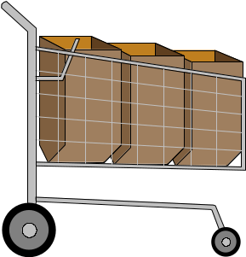
Market Basket Analysis
A
B
C
A
C
D
B
C
D
A
D
E
B
C
E

Slide 5
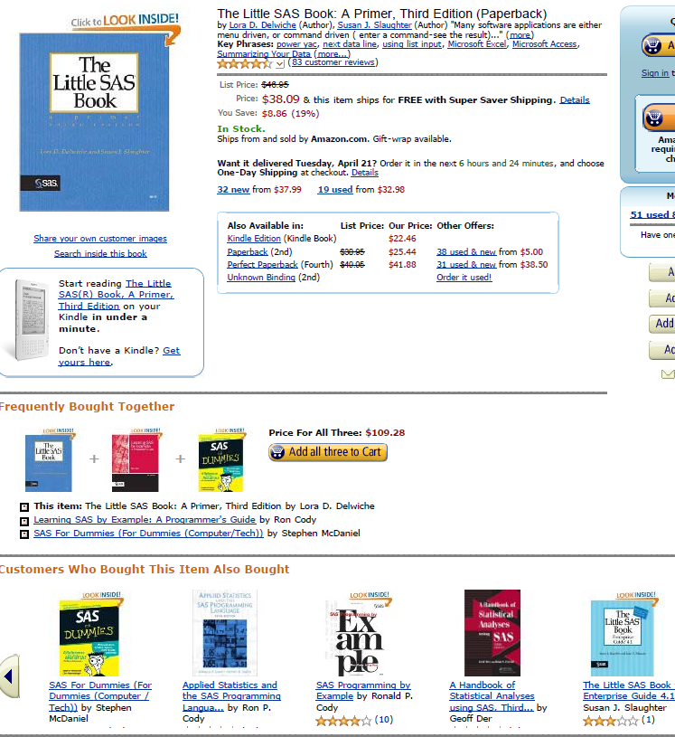
Used in many recommender systems

Slide 6
Association Rules – Terminology
Consider the rule A ⇒ B.
support of A ⇒ B is the probability that a customer has both A and B. (joint probability of A and B)
confidence of A ⇒ B is the probability that a customer has B given that the customer has A. (conditional probability of B given A)
expected confidence of A ⇒ B is the probability that a customer has B. (probability of B)
lift of A ⇒ B is confidence/(expected confidence) (conditional probability of B given A)/(probability of B)
Lift is a measure of strength of the association. If lift=2 for the rule A=>B, then a customer having A is twice as likely to have B than a customer chosen at random.

Slide 7

Market Basket Analysis
A
B
C
A
C
D
B
C
D
A
D
E
B
C
E
Rule
A ⇒ D
C ⇒ A
A ⇒ C
B & C ⇒ D
Support
2/5
2/5
2/5
1/5
Confidence
2/3
2/4
2/3
1/3

Slide 8
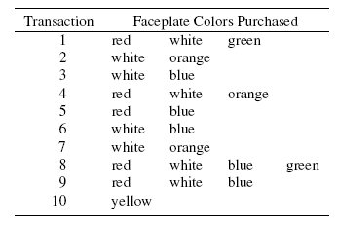
Example: Phone Faceplates

Slide 9
Red ⇒ White
Support
4 (contain red & white) /10 (total transactions) = 40%
Confidence
4 (contain red & white) /5 (contain red) = 80%
Expected Confidence
8 (contain white) / 10 (total transactions) = 80%
Lift
Confidence (80%) / Expected Confidence (80%) = 1

Slide 10
JMP (Bank-2.jmp)
Using JMP’s Row Selection feature, compute the metrics for ATM ➔CCRD.
Total Accounts =
Accounts with ATM =
Accounts with CCRD =
Accounts with ATM and CCRD =

Slide 11
Barbie Doll ⇒ Candy – So What?
Put them closer together in the store.
Put them far apart in the store.
Package candy bars with the dolls.
Package Barbie + candy + poorly selling item.
Raise the price on one, lower it on the other.
Offer Barbie accessories for proofs of purchase.
Do not advertise candy and Barbie together.
Offer candies in the shape of a Barbie doll.

Slide 12
Association Mining – other settings
Can also be used in applications with a target of interest. These, for example, include ‘response to target mailings’, ‘customer churn’, ‘delinquency’, and others.
Consider Direct Mailing.jmp. We are interested in the association of individuals with age>50 and their response.
total observations =
observations with response =
base response rate =
observations with age > 50 =
observations with response and age > 50 =

Slide 13
Association Mining – other settings
Support =
observations with age > 50 & Response
Confidence =
observations with response and age > 50/observations with age > 50
Expected confidence =
observations with response/total observations
Lift =
Confidence/Expected Confidence

Slide 14
Questions
Consider
1. “age > 50”
2. “income > $100,000”
3. “age > 50” and “income > $100,000”
Your company has asked you whether to send offers to all, to those over 50, to those with income greater than $100,000, or to those over 50 with incomes greater than $100,000. Develop your response (think beyond the computations – identify key factors)

Slide 15
Summary
Association rules produce rules on associations between items from a database of transactions
Performance is measured by confidence and lift
Problems
  Often many rules are generated and most of them are obvious.
  Random data can generate apparently interesting association rules
  Rules based on large numbers of records are less subject to this danger

